Slide 1
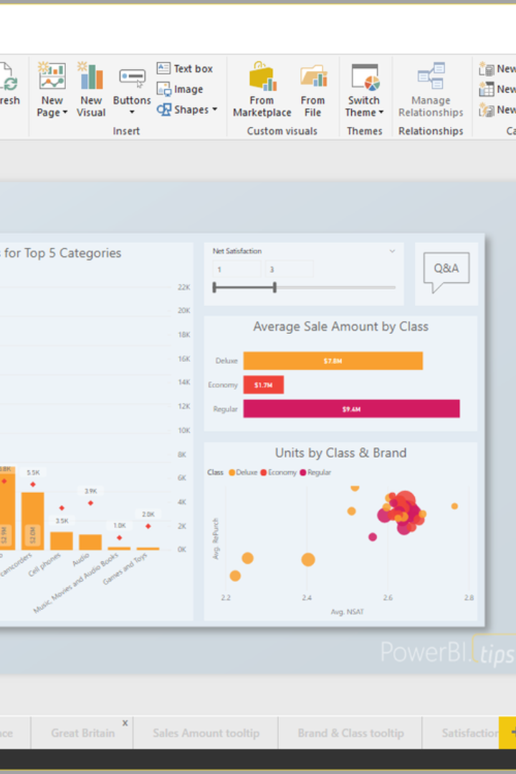
Introduction to Power BI
Power BI is a powerful business analytics tool that provides insights throughout your organization. It allows you to connect to hundreds of data sources, simplify data prep, and drive ad hoc analysis.

Slide 2
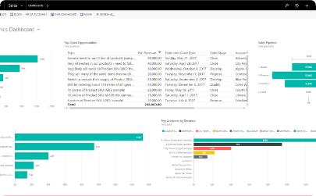
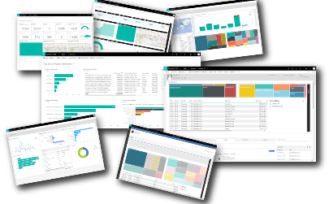
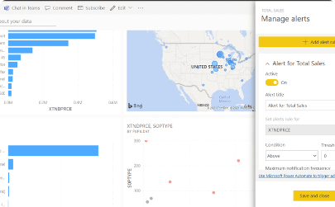
What is Power BI?
Intuitive Interface
Robust Data Visualization
Mobile Accessibility
Power BI offers a user-friendly interface, making it easy for users to create interactive reports and dashboards without the need for extensive technical skills.
Power BI supports mobile access, allowing users to view and interact with their data from anywhere, at any time, on any device.
It provides a wide range of powerful data visualization options, empowering users to create compelling visual representations of their data.

Slide 3
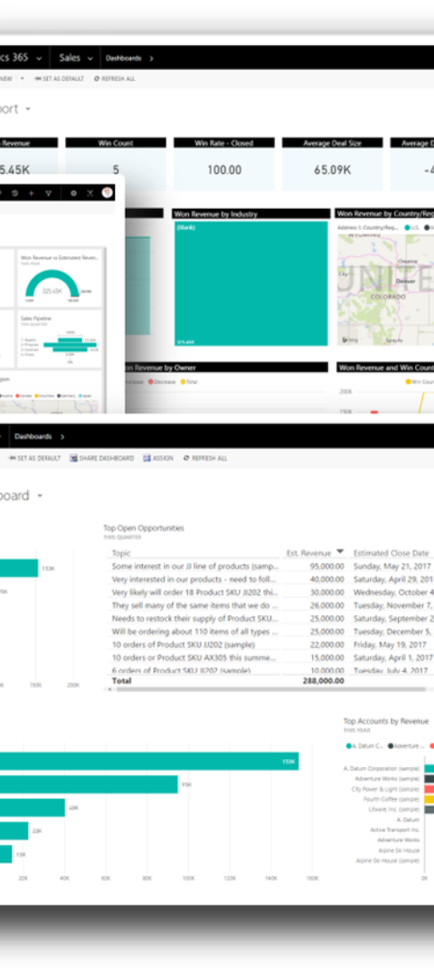
Key Features of Power BI
Data Modeling
Analytics Tools
Power BI offers advanced data modeling capabilities, enabling users to create relationships and enrich their data for deeper insights.
It provides a rich set of analytics tools, including quick insights, natural language queries, and more, to help users discover hidden patterns within their data.
Real-time Dashboards
Users can create real-time dashboards that provide up-to-date insights, keeping them informed of the latest trends and changes.

Slide 4
Benefits of Using Power BI
1
Improved Decision Making
2
Cost Efficiency
3
Scalability
It offers cost-efficient business intelligence and analytics solutions, maximizing the value of your data investment.
Power BI scales with your business, allowing you to handle enterprise-level data and analytics needs.
Power BI enables informed decision-making by providing powerful data visualizations and analytics.

Slide 5
How to Get Started with Power BI
Download and Install
Explore Sample Data
Join the Community
Begin by downloading and installing Power BI Desktop, a free application that enables you to connect to and visualize your data.
Get started by exploring the sample datasets provided to fully understand the capabilities of Power BI.
Engage with the Power BI community to gain insights, learn best practices, and stay updated with the latest features.

Slide 6
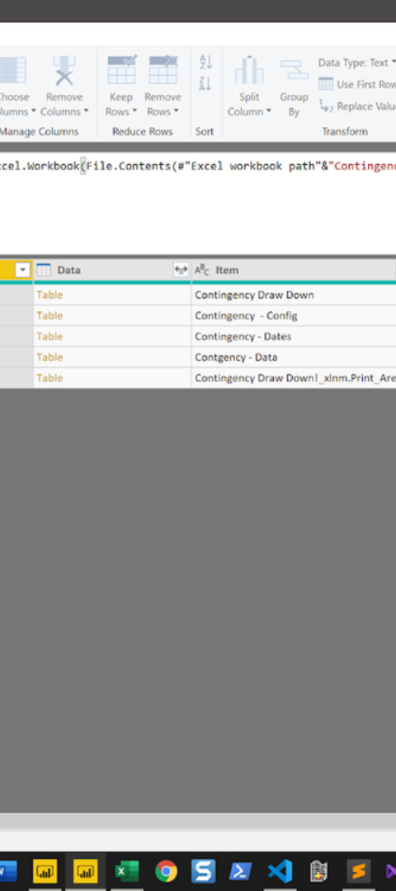
Data Sources and Connectors
1
Data Integration
Power BI offers seamless data integration with a wide range of sources including cloud services, databases, and other platforms.
2
Connectivity
Users can effortlessly connect to a variety of data platforms, ensuring that all critical data can be accessed and analyzed within Power BI.
3
Real-time Streaming
Power BI provides capabilities for real-time data streaming, allowing users to continuously monitor and analyze changing data.

Slide 7
Creating Visualizations in Power BI
Rich Visualizations
Interactive Reports
Cross-Report Drill Through
Power BI enables users to create compelling visuals such as charts, graphs, maps, and more to effectively convey insights.
It allows the creation of interactive reports and dashboards, providing users with the flexibility to explore data through dynamic visuals.
Power BI offers cross-report drill through capabilities, allowing users to navigate through related reports and gain comprehensive insights.

Slide 8




DAX, Power Query, Power Pivot
DAX Functions
Power Query
Power Pivot
Power BI's Data Analysis Expressions provide a powerful set of functions and operators for data manipulation and analysis.
The Power Query tool allows users to transform, integrate, and enrich data for analysis, ensuring data quality and consistency.
Power Pivot simplifies data modeling, enabling users to create sophisticated data models for in-depth analysis and reporting.

Slide 9
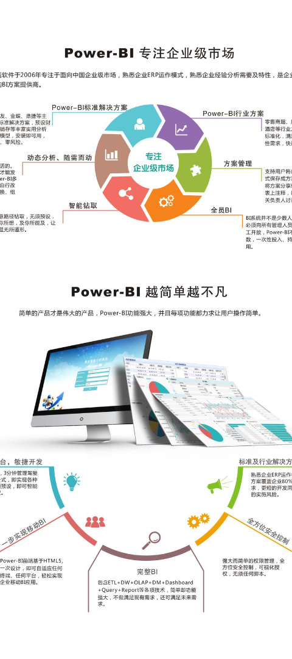
Sharing and Collaborating with Power BI
1
Share and Publish
Users can easily share reports and dashboards with colleagues, enabling seamless collaboration and decision-making across the organization.
2
Embed in Apps
Power BI offers integration options to embed reports and dashboards into applications, providing stakeholders with easy access to insights.
3
Manage and Administer
Admins have robust tools to manage access, settings, and security, ensuring the safe and efficient use of Power BI across the organization.

Slide 10
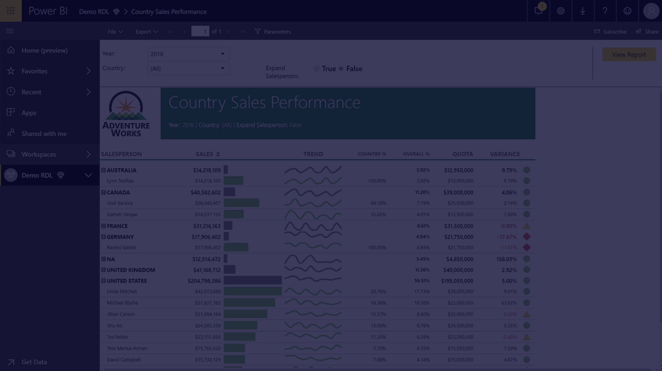
Thank You

